Slide 1
FindNGo
Hodolean Aurelian-Teofil
Cihan Ilhan
Noroc Andrei-Mihail

Slide 2
Contents
Existing solutions and the new vision
Architecture
Impact
Functionalities
Demo

Slide 3
What exists vs what we has improved
Geocaching - treasure hunt with hidden objects
Get your guide - promote touristic spots and activities
Pokemon Go - walking and trying to catch special pokemons
gamifying tourism
a dynamic exploration
fair visiting system

Slide 4
Architecture
Most challenging tasks
Best achievements
cloud infrastructure (Google Cloud + Mongo Atlas)
Google AI (Gemini Flash 2.0)
backend (NodeJs)
frontend (Kotlin, Java)
embedded
making the sparrow to work as a beacon
established connection between mobile and beacon
integrating features in smartwatch
creating an automatic update system using beacon messages
update scores for users and places based on popularity
give the user more than a brief of the mobile app in smartwatch to ease the usability

Slide 5
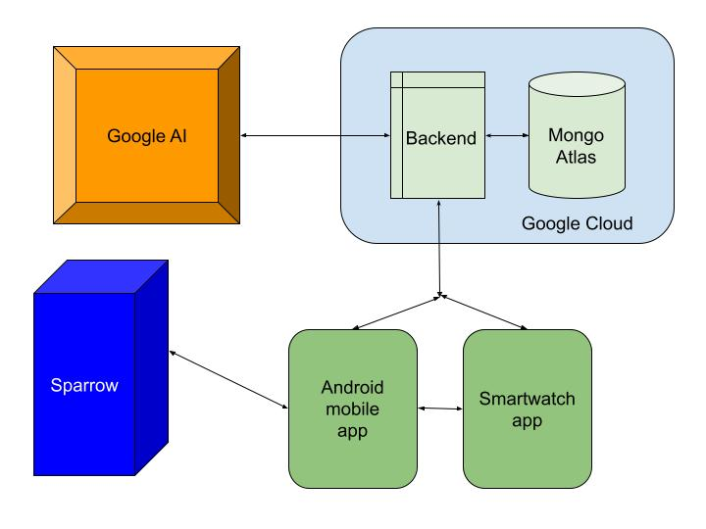

Slide 6
What? How? Why?
We created an app ecosystem that rewards city exploration using mobile, smartwatch, and Bluetooth technology to promote hidden gems, reduce overcrowding, and make urban travel more engaging.

Slide 7




Reasons

Slide 8
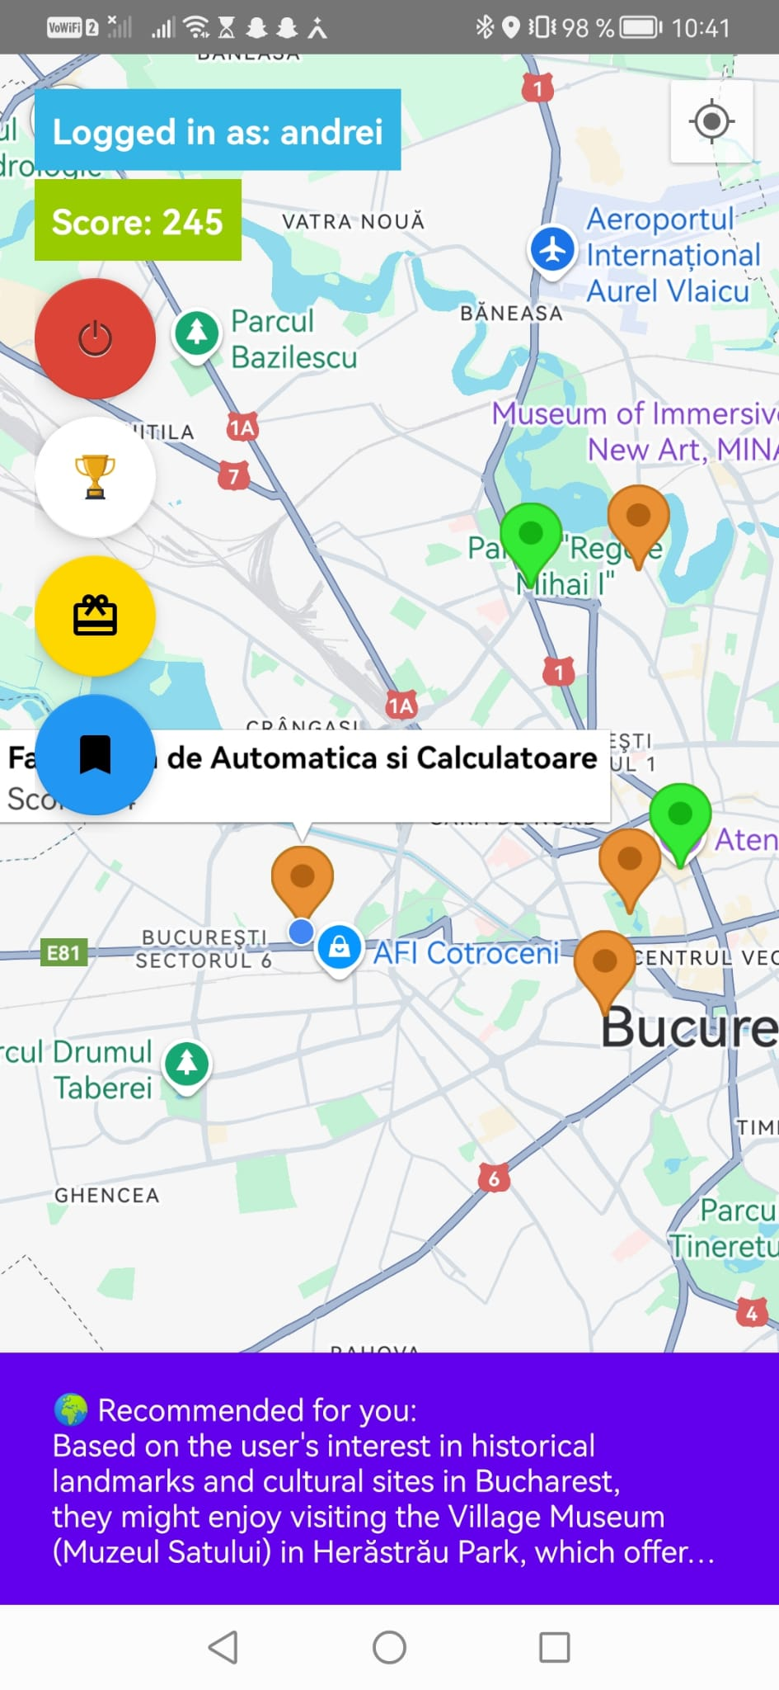
Mobile app
login/register, logout
details
update scores system
leaderboard
markup spots, highlighting the visited ones
rewards
toasts + AI recommendations based on visited places
visited spots

Slide 9
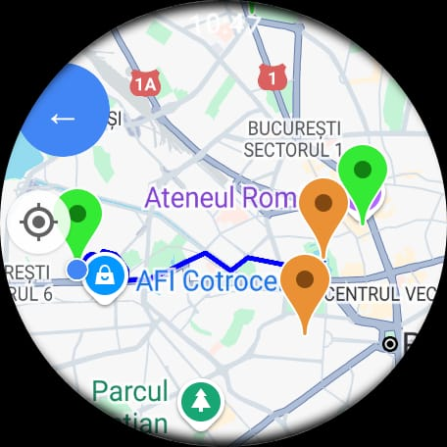
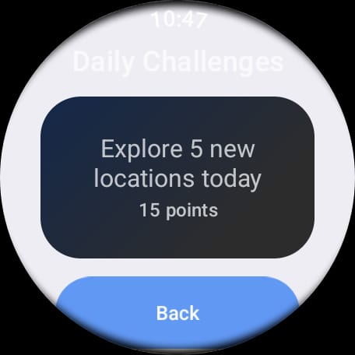
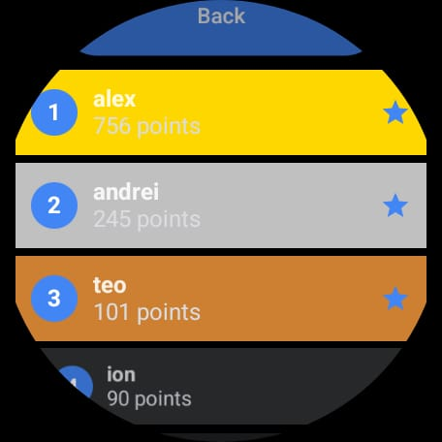
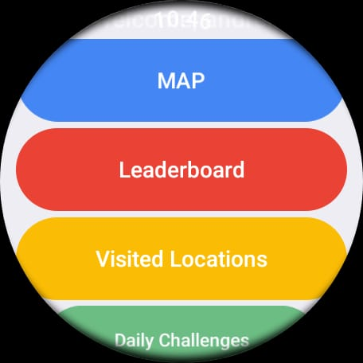
Smartwatch app
sync with mobile app
leaderboard
daily challenges
routes on maps
markup spots, highlighting the visited ones
visited spots

Slide 10
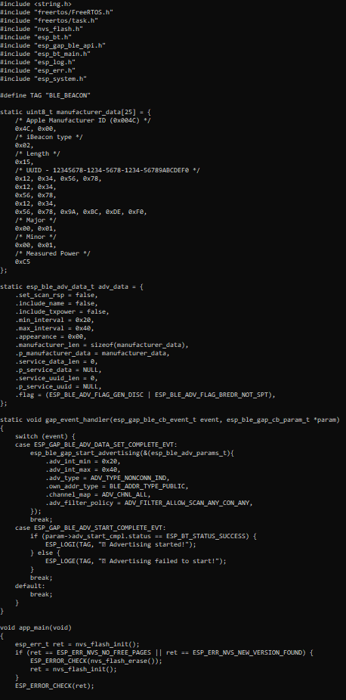
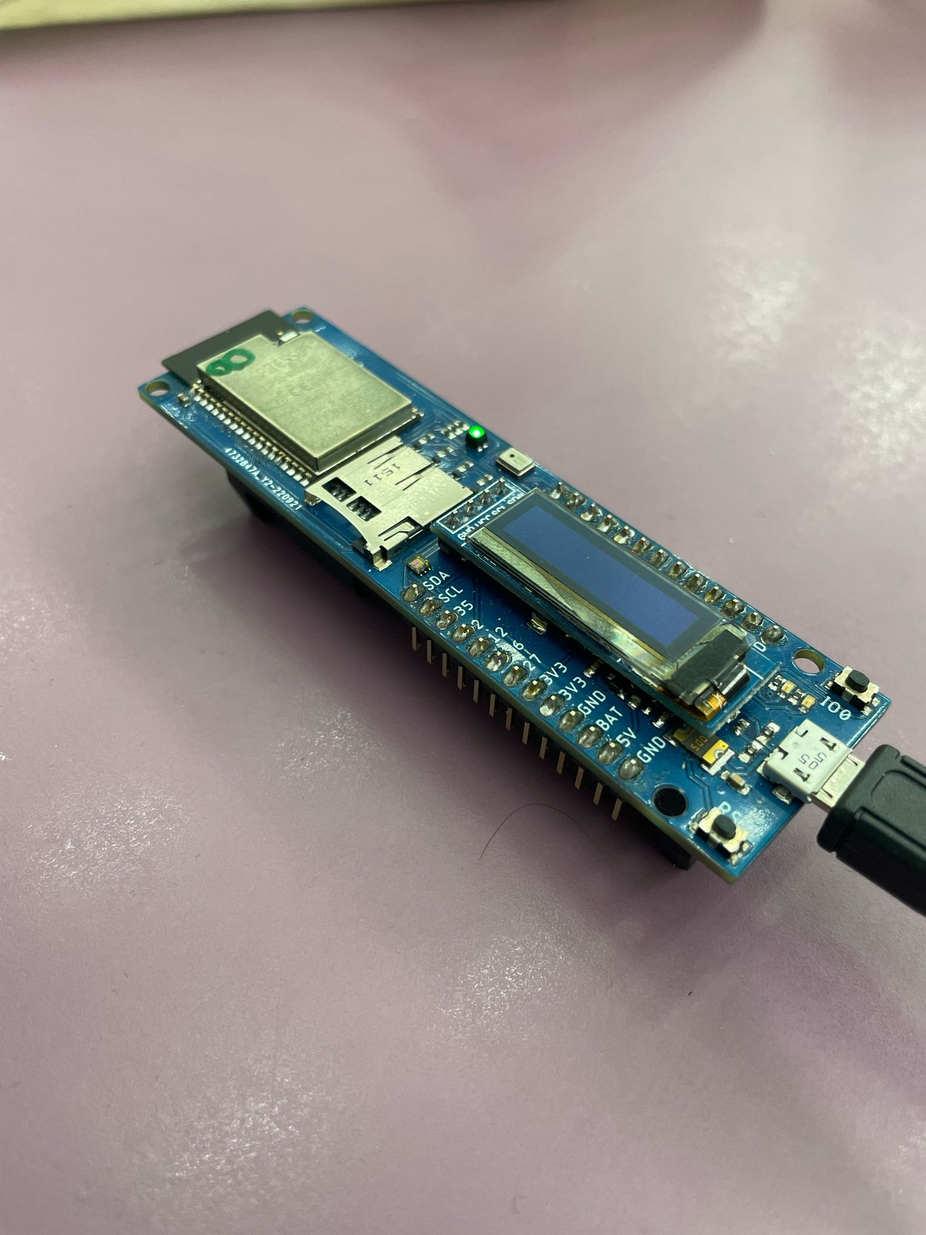
Sparrow
beacon
spread messages using bluetooth
scope: to index the locations

Slide 11
Demo

Slide 12
Thank you for your attention!

